Slide 1

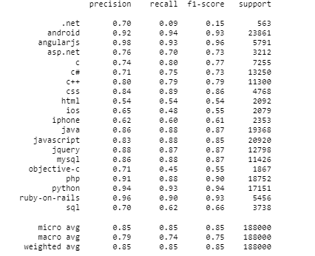
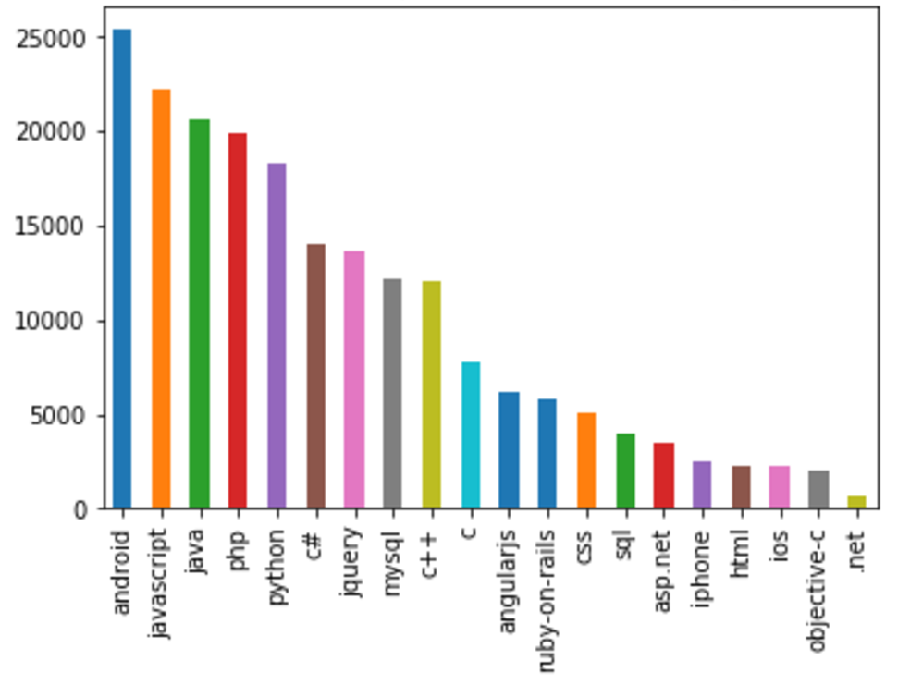
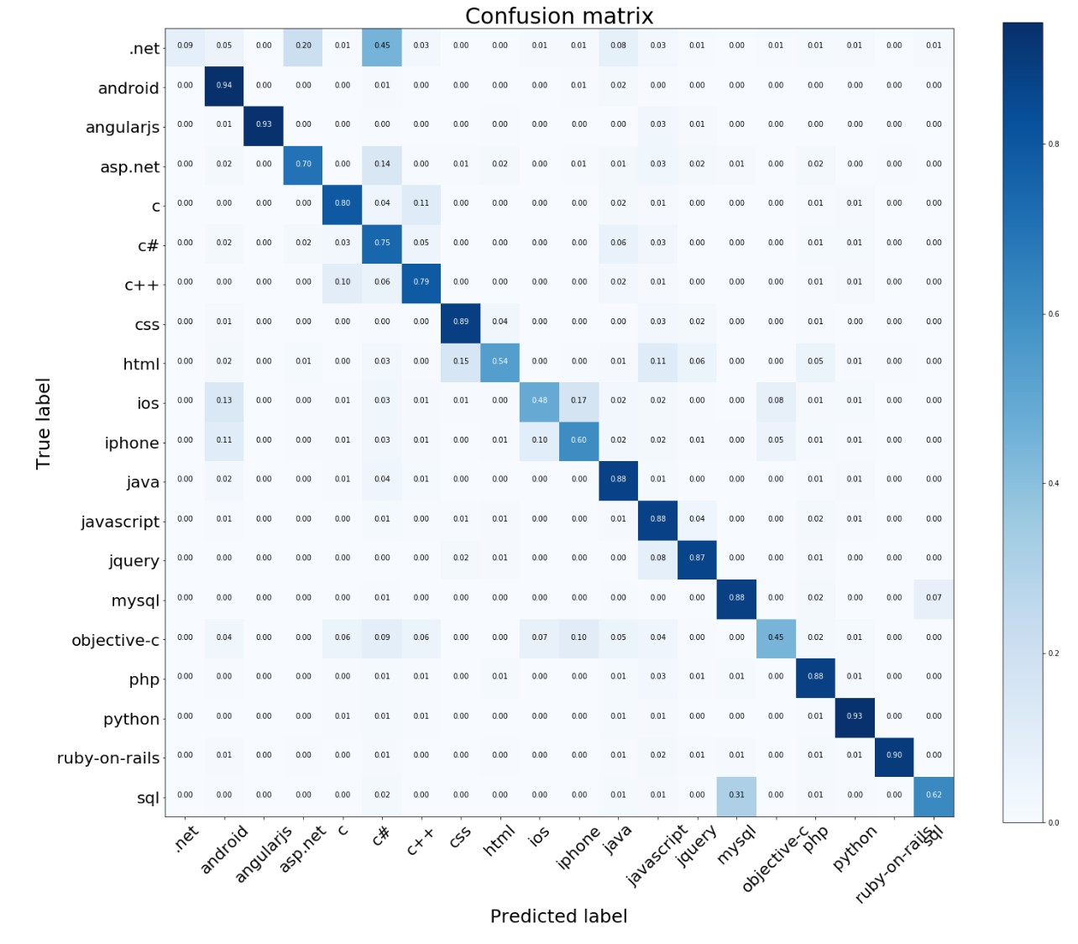


Project Name
Nicholas Wiley, Harsha Suresh, Yuhan Cui, Tianjiao Liu
Introduction
Literature Review
RESULTS
CONCLUSIONS
Corporate intranet discussion forums are a valuable tool for software development companies. The discussion forums enable employees to facilitate content creation, customer support, community-based support, project management, project collaboration, and knowledge base creation. We used Stack Overflow as a proxy for a corporate intranet forum because we could not gain access to a private company’s proprietary intranet forum. Stack Overflow data can be scraped from the internet, has a question and answer section, and tags for questions categorization. Private intranet forums would be structurally different with far fewer users, but Stack overflow is a suitable proxy to compare a question content and tagging system. Stack overflow’s robust tagging system predicts tags based on inputs and user history. For the purposes of our analysis we identify a use case where it is necessary for the tagging system to predict tags based on the question content. Sorting through the categories of these questions both internally and externally is time consuming and AI categorization based on tags would be a time saver for askers and answers. In this analysis we will test Fully Connected Feed Forward (FCFW) networks and identify the network with the highest accuracy.
There are many examples of using Fully Connected Feedforward networks to tag a corpus of text. After completing our analysis, we identified another developer who categorized stack Overflow, from the Data Driven Investor. The analysis used a multi-tag classification and logistic regression. They achieved an accuracy of 23 percent.
Here, the developer has tried a similar approach by restricting the number of tags. They have also omitted the ‘title’ column, choosing instead to base their analysis solely on the question the user asks. Their logistic regression model trained by the doc2vec features achieved their highest accuracy of 80.45%. Our goal was to determine if including the title in the analysis improved the classification accuracy.
Since this is a multi_class classification problem with 20 classes, using the common class as a baseline (~12%) didn’t seem to be a valid approach. Using a random guess probability(5%) was also out of the question so we concluded that the best way to asses our models would be by comparing them to each other. To establish a logical baseline, a Naïve Bayes classifier was used.
According to the classification report, the classes with lowest precision are ’html’, ‘ios’ , ‘iphone’ and ‘.net’from the confusion matrix, of all the observations was misclassified under the label ‘html’, 15% is in ‘css’, and 11% is in ‘javascript’, that probably because the syntax of these 3 language have a lot of similarities. We also observe a 40% misclassification rate between ‘C#’ and ‘.net’. This is due to the fact that knowledge of c# implies some knowledge of .net. Finally, the labels ‘iphone’ and ‘ios’ are classes that easily get confused with each other, combining these two columns would likely result in a lower misclassification rate.
Of the models that we used, the Fully connected feedforward network with both the title and post column had the highest accuracy ~85.33 percent. This is much higher than a random set with 20 classes.
Our analysis of the stack overflow data would reinforced what many have observed. Categorizing a large number of features decreases the accuracy of the network. In the case of our 20 features, the feed forward network with both the title and the post columns performed the best.
For a corporation to use a neural network to tag their corporate internet forums they would benefit greatly from having a post and body column similar to the ones that we identified. A great amount of time can be saved. To improve our analysis we would have greatly benefited from internal access to a corporate intranet forum. Companies can benefit from creating requirements to post to their intranet forum which contain a title and body of text. These should have input requirements and not accept characters which cannot be cleared from the data. Analysis of our methods could benefit companies both looking to implement internal corporate intranet forums and to read their existing forums.
Table 1. The Classification Report
Implications and Limitations
We discussed attempting multi tag classifications and more complex models, but encountered some issues during our analysis. This was mainly due to our lack of computational power and programming experience.
Methodology
Use the Scikit-learn package to process the raw data and generate features.
Partition the dataset into training dataset and validation dataset.
Use the Fully Connected Feedforward Network model on the training dataset and use the validation set to test it.
Pick the commonest tag as the baseline to compare our model with.
Try other models on the same training and validation datasets and compare the outputs to choose the best one.
Apply this model on new comments.
Reference
https://towardsdatascience.com/multi-class-text-classification-model-comparison-and-selection-5eb066197568
Multi-Class Text Classification Model Comparison and Selection Natural Language Processing, word2vec, Support Vector Machine, bag-of-words, deep learning -Susan Li
https://medium.com/datadriveninvestor/predicting-tags-for-the-questions-in-stack-overflow-29438367261e
Predicting Tags for the Questions in Stack Overflow-Megha Shyam
https://stackoverflow.com/questions/43196636/how-to-concatenate-two-layers-in-keras/46442161#46442161
Figure 1. Number of questions under each tag.
Figure 2. Confusion matrix.

